Slide 1








TURING
MACHINES
PRESENTED BY - V.CHANDANA

Slide 2

CONTENT
INTRODUCTION
FORMAL DEFINITION
RULES
EXAMPLE

Slide 3
INTRODUCTION
Turing machines are used to study the properties of algorithms and to determine what problems can and cannot be solved by computers. They provide a way to model the behaviour of algorithms and to analyze their computational complexity, which is the amount of time and memory they require to solve a problem.
A Turing machine is a finite automaton that can read, write, and erase symbols on an infinitely long tape. The tape is divided into squares, and each square contains a symbol. The Turing machine can only read one symbol at a time, and it uses a set of rules (the transition function) to determine its next action based on the current state and the symbol it is reading.

Slide 4
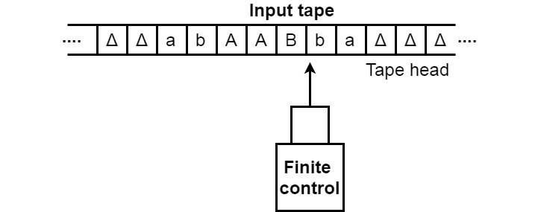
FORMAL DEFINITION
A turing machine consists of a tape of infinite length on which read and writes operation can be performed. The tape consists of infinite cells on which each cell either contains input symbol or a special symbol called blank. It also consists of a head pointer which points to cell currently being read and it can move in both directions.

Slide 5
FORMAL DEFINITION
A Turing Machine is expressed as a set of 7-tuple (Q, T, B, ∑, δ, q0, F) where:
Q is a finite set of states
T is the tape alphabet (symbols which can be written on Tape)
B is blank symbol (every cell is filled with B except input alphabet initially)
∑ is the input alphabet (symbols which are part of input alphabet)
δ is a transition function which maps Q × ∑ → Q × T × {L,R}. Depending on its present state and present tape alphabet (pointed by head pointer), it will move to new state, change the tape symbol (may or may not) and move head pointer to either left or right.
q0 is the initial state
F is the set of final states. If any state of F is reached, input string is accepted.

Slide 6
RULES
Read the current symbol
Update (i.e. write) the same cell
Move exactly one cell either LEFT or RIGHT
If you don't want to update the cell, JUST WRITE THE SAME SYMBOL
If we are at the left end of the tape, and trying to move LEFT, then do not move.Stay at the left end
Final States: (there are two final states)
The ACCEPT STATE
The REJECT STATE
Computation can either
HALT and ACCEPT
HALT and REJECT
LOOP ( the machine fails to HALT)
q1
a->b,R
q2
a: Symbol to read
b: Symbol to write
R/L : Right or Left directions to move

Slide 7
EXAMPLE
Design a Turing Machine which recognizes the language L = 01*0
1->y, R
A
0->x, R
B
0->x, R
C
[
[
-> ,R
[
[
1->1, R
-> ,R
1->1, R
[
[
-> ,R
REJECT
0->0, R
ACCEPT

Slide 8
TAPE
LET US CONSIDER A STRING 0110 WHICH IS PRESENT IN THE LANGUAGE
L = 01*0
X
X | Y | Y
X | Y | Y | X
X | Y
X | Y | Y | X
[

Slide 9
THANK
YOU

